Slide 1
Enzymes
Year 11 Biology
Bremer SHS

Slide 2
Subject matter
Recognise that biochemical processes are controlled and regulated by a series of specific enzymes
Identify factors that affect enzyme activity and rates of reaction
Describe the structure and role of an active site of an enzyme
Explain, using an example, how the arrangement of internal membranes can control biochemical processes.

Slide 3
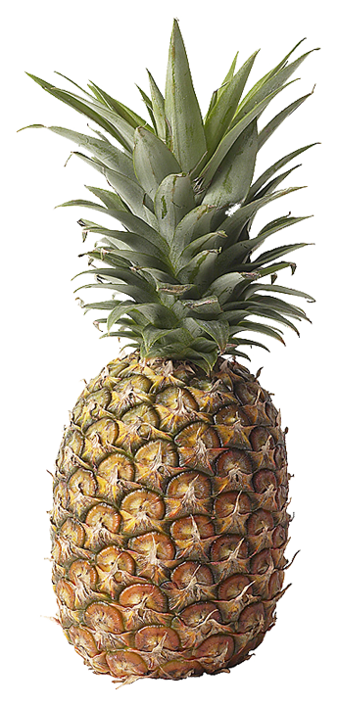
Enzymes
Enzymes are molecules that act as catalysts to speed up biological reactions.
Enzymes are not consumed during the biological reaction.
The compound on which an enzyme acts is the substrate.
Enzymes can break a single structure into smaller components or join two or more substrate molecules together.
Most enzymes are proteins.
Many fruits contain enzymes that are used in commercial processes. Pineapple (Ananas comosus, right) contains the enzyme papain which is used in meat tenderization processes and also medically as an anti-inflammatory agent.

Slide 4
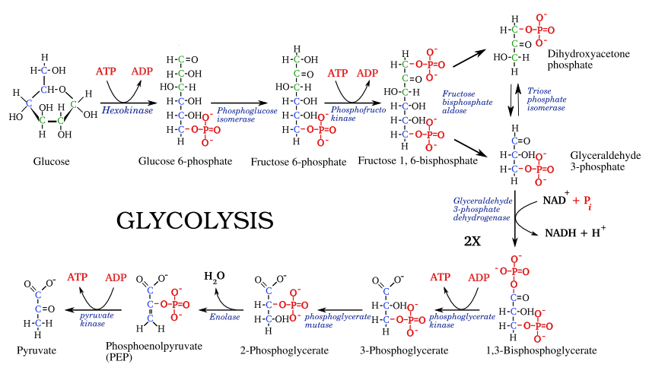
Why are enzymes important?
Important chemical reactions that occur in cells are entirely enzyme dependent.
Eg. pathway involved in production of ATP from glucose molecules.

Slide 5
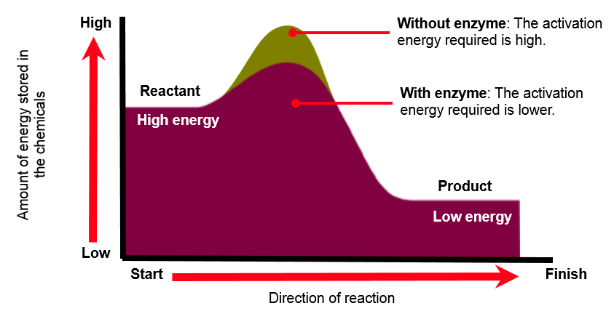
Enzymes
Catalysts speed up reactions by influencing the stability of bonds in the reactants. They may also provide an alternative reaction pathway, thus lowering the activation energy needed for a reaction to take place.
High energy
Low energy

Slide 6
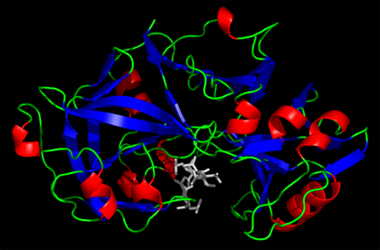
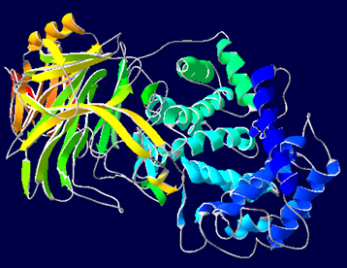
Enzyme Examples
Enzyme | Role
Pepsin | Stomach enzyme used to break protein down into peptides. Works at very acidic pH (1.5).
Lactase | A digestive enzyme that breaks lactose into glucose and galactose. Low levels of lactase can result in lactose intolerance.
Topoisomerase | A family of enzymes that act on the coiled structure of DNA. They cut the DNA to alter the coiled structure.
Hyaluronidase | A family of enzymes that break down hyaluronic acid and increase tissue permeability. Often used during eye surgery to administer local anesthetics faster.
Zymase | A naturally occurring enzyme in yeasts, widely used in the baking industry to ferment sugar into ethanol and carbon dioxide.
3D molecular structures for the enzymes pepsin (top) and hyaluronidase (bottom).

Slide 7
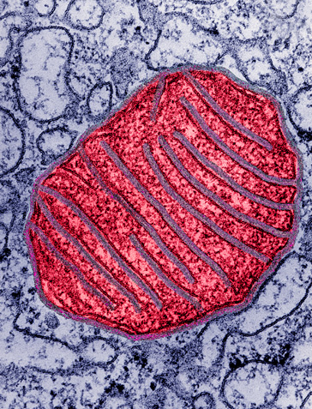
Increasing the rate of biochemical processes in a cell
The mitochondria are the site of cellular respiration, in which ATP is generated from fuels such as glucose.
Mitochondria are enclosed by an envelope of two membranes.
The outer membrane controls the passage of materials involved in aerobic respiration.
Inner membranes (cristae) provide the attachment sites for the enzymes involved in cellular respiration.
Folding of the inner membranes increases the surface area available for enzyme controlled reactions to occur.

Slide 8
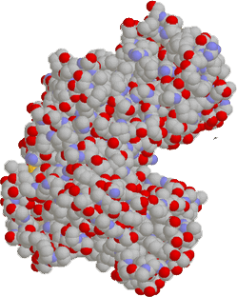
Enzymes
Enzymes have a specific region where the substrate binds and where catalysis occurs. This is called the active site.
The active site is usually a cleft or pocket at the surface of the enzyme. Substrate modification occurs at the active site.
Enzymes are substrate-specific, although specificity varies from enzyme to enzyme:
High specificity: The enzyme will only bind with a single type of substrate.
Low specificity: The enzyme will bind a range of related substrates, e.g. lipases hydrolyze any fatty acid chain.
When a substrate binds to an enzyme’s active site, an enzyme-substrate complex is formed.
Space filling model of the yeast enzyme hexokinase. Its active site lies in the groove (arrowed)

Slide 9
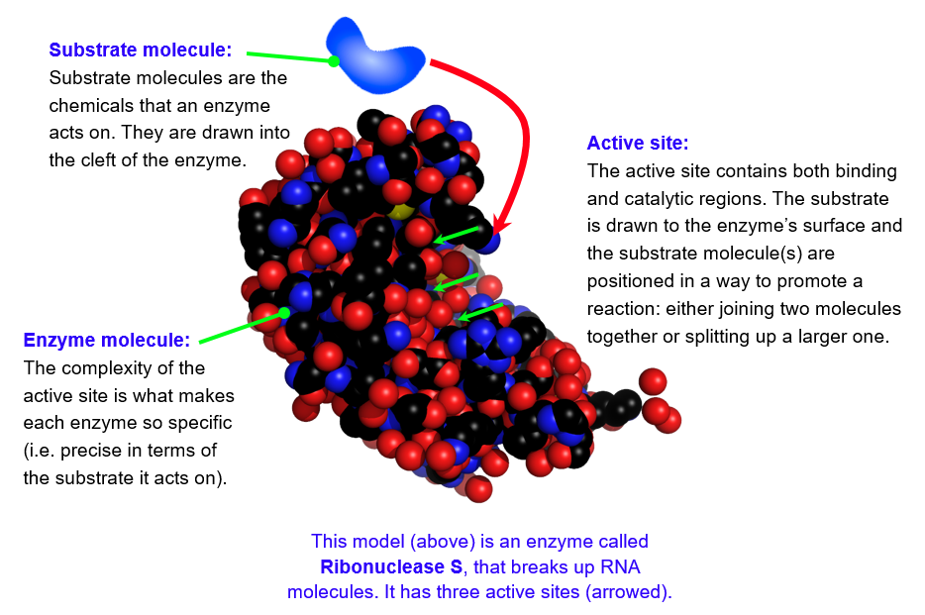
Enzyme active sites

Slide 10







Lock and Key Model
The lock and key model of enzyme action, proposed earlier this century, proposed that the substrate was simply drawn into a closely matching cleft on the enzyme molecule.
Substrate
Products
Enzyme

Slide 11


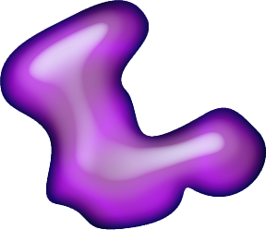
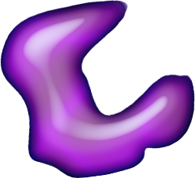
Induced Fit Model
Two substrate molecules are drawn into the cleft of the enzyme.
More recent studies have revealed that the process is much more likely to involve an induced fit.
The enzyme or the reactants (substrate) change their shape slightly.
The reactants become bound to enzymes by weak chemical bonds.
This binding can weaken bonds within the reactants themselves, allowing the reaction to proceed more readily.
The enzyme changes shape, forcing the substrate molecules to combine.
The resulting end product is released by the enzyme which returns to its normal shape, ready to undergo more reactions.

Slide 12
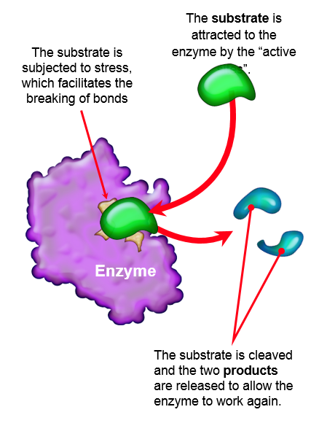
Catabolic Reactions
Catabolic reactions involve the breakdown of a larger molecules into smaller components, with the release energy (they are exergonic).
Chemical bonds are broken, causing the substrate molecule to break apart to become two separate molecules.
Catabolic reactions include:
Digestion: Breakdown of large food molecules.
Cellular respiration: Oxidative breakdown of fuel molecules such as glucose.
Enzyme

Slide 13
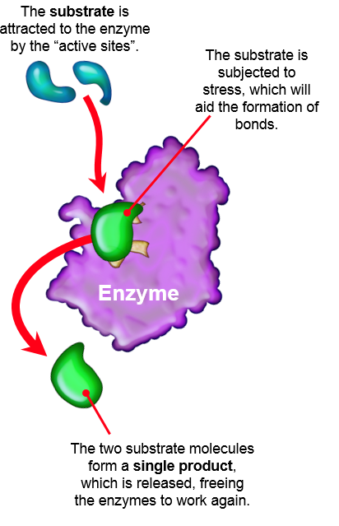
Anabolic Reactions
In anabolic reactions, smaller molecules are joined to form larger ones.
These reactions are endergonic; they require the input of energy.
New chemical bonds are formed resulting in the formation of a single molecule.
Examples include:
Protein synthesis: Build up of polypeptides from peptide units.
Cellular respiration: Oxidative breakdown of fuel molecules such as glucose.
Enzyme

Slide 14
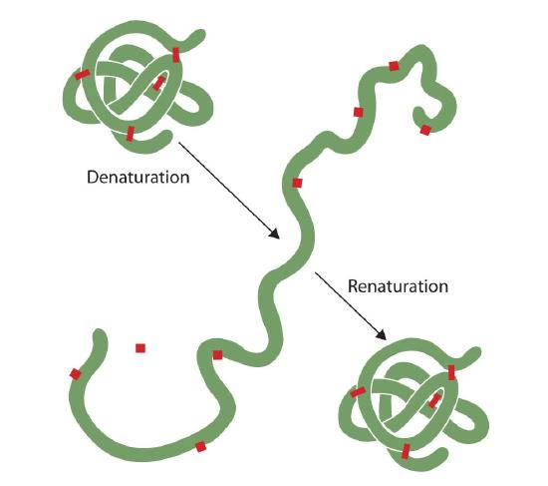
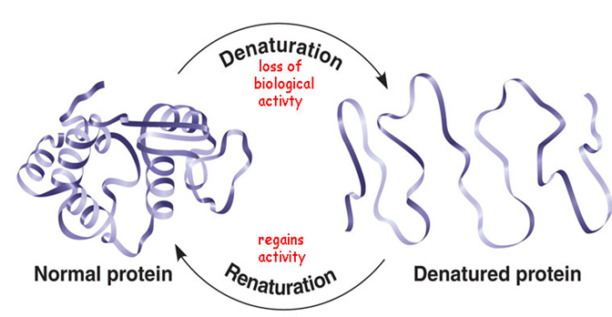
Enzyme denaturation
If conditions are unfavourable, the structural bonds of an enzyme may be affected.
The shape active site of an enzyme may be changed if the structural bonds of an enzyme are altered or lost.
Loss of an active site will render the enzyme useless until the enzyme returns to favourable conditions.

Slide 15
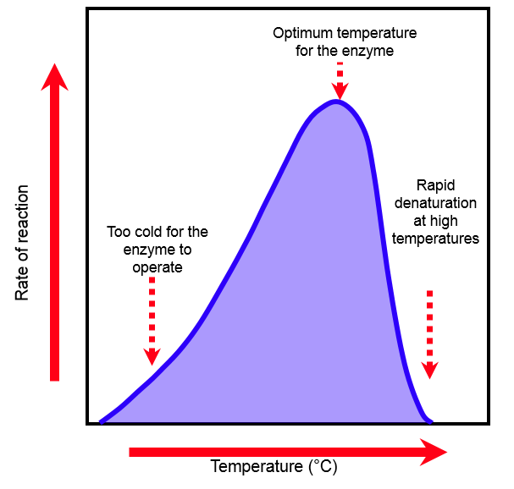
Effect of Temperature
Enzymes often have a narrow range of conditions under which they operate properly.
For most plant and animal enzymes, there is little activity at low temperatures.
Enzyme activity increases with temperature, until the temperature is too high for the enzyme to function. At this point, enzyme denaturation occurs and the enzyme can no longer function.

Slide 16
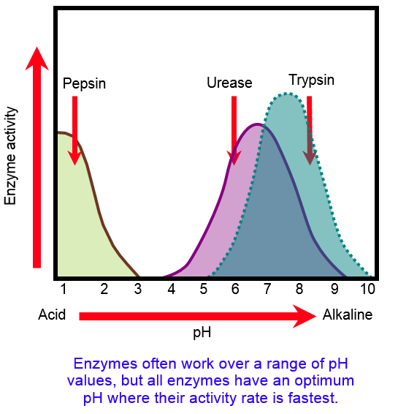
Effect of pH
Enzymes can be affected by pH.
Extremes of pH (very acid or alkaline) away from the enzyme optimum can result in enzyme denaturation.
Enzymes are found in very diverse pH conditions, so they must be suited to perform in these specialist environments.
Pepsin is a stomach enzyme and has an optimal working pH of 1.5, which is suited for the very acidic conditions of the stomach.

Slide 17
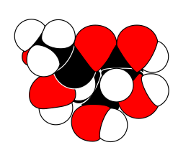
Factors Affecting Enzyme Reaction Rates
Effect of Enzyme Concentration
Effect of Substrate Concentration
Rate of reaction
Enzyme concentration
Rate of reaction continues to increase with an increase in enzyme concentration.
This relationship assumes non-limiting amounts of substrate and cofactors.
Concentration of substrate
Rate of reaction increases and then plateaus with increasing substrate concentration.
This relationship assumes a fixed amount of enzyme.

Slide 18
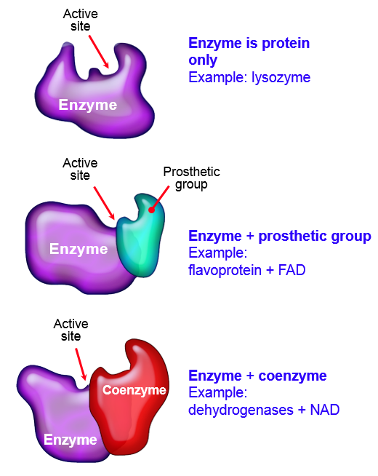
Enzyme Cofactors
Some enzymes require cofactors to be active.
Cofactors are a non-protein component of an enzyme.
Cofactors can be:
organic molecules (coenzymes).
inorganic ions (e.g. Ca²⁺, Zn²⁺).

Slide 19
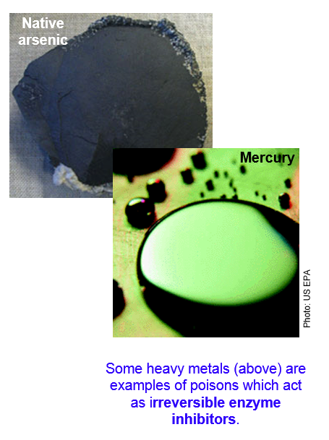
Enzyme Inhibitors
Enzymes can be deactivated by enzyme inhibitors.
There are two types of enzyme inhibitors:
Reversible inhibitors are used to control enzyme activity. There is often an interaction between the substrate or end product and the enzymes controlling the reaction.
Irreversible inhibitors bind tightly and permanently to the enzymes destroying their catalytic activity. Irreversible inhibitors usually covalently modify an enzyme.
Many drug molecules are enzyme inhibitors.

